Slide 1
  Core Java
  Statements in Java
LEVEL – PRACTITIONER

Slide 2
Objectives
After completing this chapter you will be able to,
  Use decision control structures
    If
    If-else
    Switch
  Apply repetition control structures
    While
    Do-while
    For
  Implement branching statements
    Break
    Continue
    Return

Slide 3
Java Statements and Blocks
What is a Statement?
A statement is a complete instruction terminated by a semi-colon.
    Example: Assignment Statement
    String name=“Ram”;
What is a Block?
    A block is group of statements enclosed in curly brackets.
    Example:
    {
      name=“Ramesh”;
      age=12;
    }
Executed First
Executed Second
Java executes one statement after the other in the order they are written

Slide 4
Java Control Statements
What are Control Statements?
The control statements allows developers to control the flow of program’s execution based upon some conditions during run time.
The control statements allows developers to,
  Repetitive execution of statements – Executing a statement ‘N’ number of times
  Conditional execution of statements – Execute statements based on some condition.

Slide 5
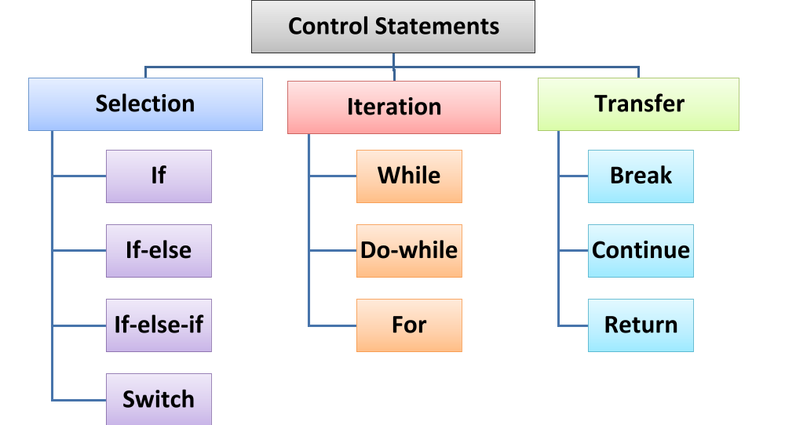
Control Statements - Categories

Slide 6
Selection Statements
What are Selection statements?
Selection statements allow the program to choose different paths of execution based upon the outcome of an conditional expression or the state of a variable.
Java supports the following selection statements
      if else statement
      switch statement

Slide 7
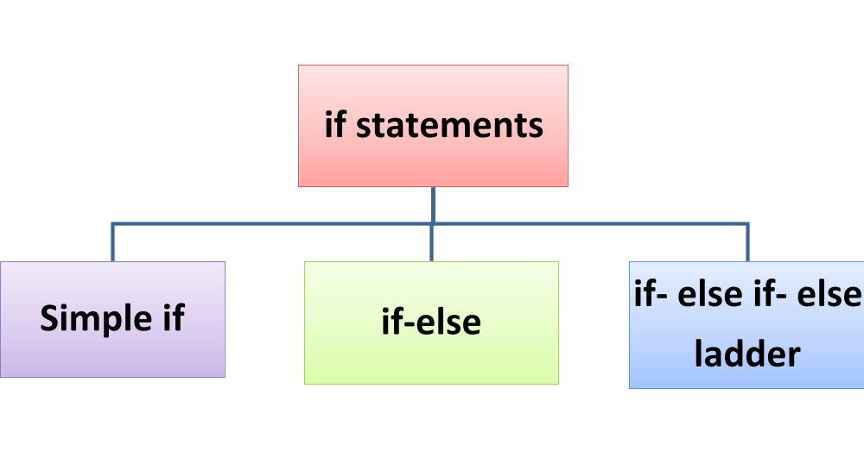
Selection Statement - IF
If Statement:
The if statements can check conditions starting from very simple to quite complex and execute statements.
Conditions are nothing but a single relational expression or the combination of more than one relational expressions with logical operators. If statement comes in three different constructs

Slide 8
A simple If Statement
Features of Simple If statement:
  The simple if statement allows the execution of a single statement or a block of statements enclosed within curly braces.
  The if statement handles a very simple situation and executes only when the condition is true otherwise the whole statement body is skipped .
  Illustration:
if (condition is true)
Yes
No
Execute statements.
Skip the block and execute other statements

Slide 9
Simple If Statement
Syntax of Simple If statement:
Option I:
if(condition1 ) {
  //statement body;
}
Option II:
if(condition1 && condition2){
  //statement body;
}
  The condition can be a single relational expression or a combination of more than one relational expression separated using a logical operators

Slide 10
If Statement Example
Examples of a simple If statement:
  Example1: Without curly braces
    int a = 10;
    int b = 20;
    If(a>b)
      System.out.println(“Value of a is greater than b”);
  Example2: With curly braces
  int empId=126;
  int retirementAge=58;
  int empAge=34;
  if((empAge<retirementAge) && (empId==126)){
    System.out.println(“Calculate Salary ”);
  }
If both the condition age and id are satisfied the message will be printed.
It is a good programming practice to use the curly braces regardless of whether there is one or more statements.

Slide 11
If-else Statement
What is an if-else statement?
+ =
If-else can handle two blocks of code, and only one of those blocks will be executed based on the condition outcome.
Syntax
  if( <condition1> ) {
    statements
  }
  else{
    statements
  }
Simple If statement
Else statement for alternative flow
If-else Statement
If condition1 is satisfied these statements are executed
If condition1 is not satisfied these statements are executed

Slide 12
If-else Statement Example
Example of an if-else statement:
int empId=126;
int retirementAge=58;
int empAge=34;
if( (empAge<retirementAge) && (empId==126) ){
  System.out.println(“Calculate Salary ”);
  }
else
{
  System.out.println(“Calculate Pension”);
}
If both the condition age and id are satisfied the message will be printed.
If the conditions in if block is not satisfied, this block will be fired.

Slide 13
If-else if Statement
What is an if-else if statement?
If-else if can handle more than two blocks of code, and only one of those blocks will be executed.
Syntax
  if( <condition1> ) {
    statements
  }
  else if(<condition2>){
    statements
  }
  else{
    statements
  }
Multiple If-else statements
If-else If or ladder if-else Statement
If condition1 is satisfied these statements are executed.
If condition1 is not satisfied and condition2 is satisfied these statements are executed.
If both conditions are not satisfied these statements are executed.

Slide 14
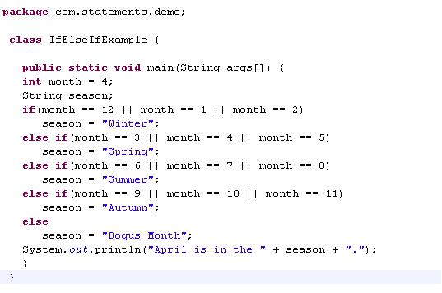
If-else if Statement Example
If statement
Else If statement
Else statement

Slide 15
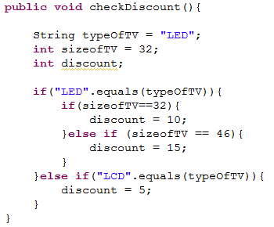
Nested if Statements
What is a nested if statement?
  The if statement in java can be nested, in other words, an if statement can be present inside another if statement
  Example:
  The discount % of T.V is calculated based on the below criteria
    If T.V is LED, check the screen size
    If screen size is 32, discount % = 10
    If screen size is 46, discount % = 15
    If T.V is LCD, discount % = 5
Nested if statement
If the type of TV is LED, then size check is done

Slide 16
Lend a Hand – If-else if
Create a java class “NumberCheck” add a method displayBigNumber three int parameters “num1” ,”num2” and “num3”.
The method displayBigNumber will check and print the biggest of the three numbers in the following format
    “<result> + is the Biggest Number”
Create a java class “MainProgram” add a main method which will
  Create a object instance of the NumberCheck.
  Trigger the method displayBigNumber by passing values of num1,num2, and num3 as 11,18 and 7.
The message needs to be displayed in the console.

Slide 17
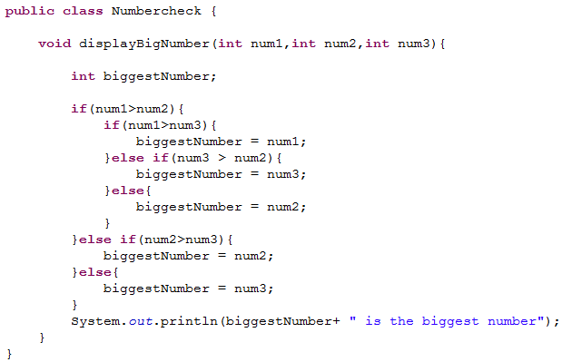
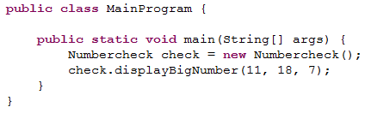
Lend a Hand –Solution
Solution

Slide 18






Switches in Real life
In the below illustration the respective switches are used to control the working of the respective electrical appliances.
Example: Switch on Fan use the fan switch and so on….

Slide 19
Switch Statement
Similarly when developing software applications to control the flow of execution in executing a particular block of statements we use the switch statement.
The switch statement allows to choose a block of statements to run from a number of option available.
This can also be implemented using nested if-else. So what is the difference. We will see the difference soon.

Slide 20
How to write Switch Statement
Syntax:
switch (expression) {
case value1:
// statement sequence
break;
case value2:
// statement sequence
break;
case value N:
// statement sequence
break;
default:
// default statements
break;
}
Get electrical appliance name
fan
true
Use fan switch;
break;
false
light
true
Use light switch;
break;
false
A.C
true
Use A.C switch;
break;
false
default block statements

Slide 21
Switch Statement Example
Example:
int x=6%2;
switch (x){
case 0:
System.out.println("The value of x is 0." );
break;
case 1:
System.out.println("The value of x is 1." );
break;
default:
System.out.println("The value of x is default.");
break;
}
The argument of switch() must be one of the types byte, short, char, int
There should be no duplicate case labels i.e., the same value cannot be used twice.

Slide 22
How Switch works?
Lets see how Switch works without break statements,
Assume the value of X is 10
switch (x){
case 12:
//Statements
break;
case 10:
//Statements
break;
case 15:
//Statements
break;
Default:
//Statements
break;
}
switch Statement Executed
case 10 condition passes
Case 10 statements executed
Break statement executed and control goes outside the switch block.
Break statement breaks the execution control flow and control passed outside the switch block.

Slide 23
How Switch works without break?
Lets see how Switch works without break statements,
Assume the value of X is 10
switch (x){
case 12:
//Statements
case 10:
//Statements
case 15:
//Statements
Default:
//Statements
}
switch Statement Executed
case 10 condition passes
case 10 statements executed
Since case 10 block does not have break the case 15 and the default block statements will be executed .
After all the cases statements are executed the control goes outside the switch blocks.

Slide 24
Switch Statement
Some facts about switch statement:
  Java first evaluates the switch expression and jumps to the case which matches the value of the expression
  Once the correct match is found, all statements from that point are executed till a break statement is encountered
  Once break statement is encountered, the flow jumps to the statements after the switch structure
  If none of the cases are satisfied, default block is executed. The default block does not have to be at the end of the switch.

Slide 25
Switch Vs IF
if-else | switch
This can test expressions based on ranges of values or conditions. Example: if(a==10 && b=21) | This tests expressions based only on a single integer, enumerated value, or String object. Example: switch(i)// where I is an int.
Based on the condition to be evaluated developers can either go for switch or if-else.

Slide 26
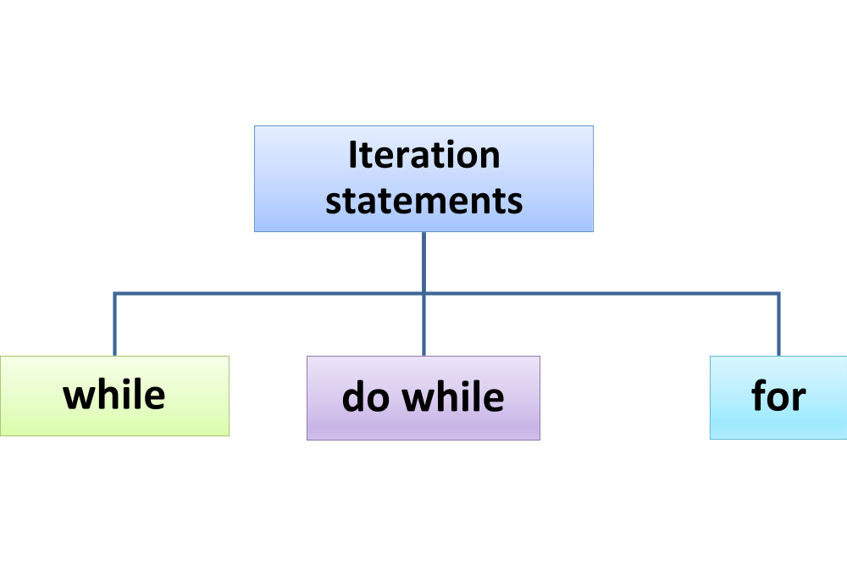
Iteration Statement
What are Iteration statements?
Iteration Statements are used execute a block of statements repeatedly as long as a certain condition is true.
A single relational expression or the combination of more than one relational expression with logical operators are given as conditions.
Java offers three iteration constructs

Slide 27
While Statement
The while loop is Java’s most fundamental iteration statement.
Simple Problem statement to understand the usage of while statement:
  John has to develop a small java program which needs to print a welcome message as long as the number of guests is greater than zero.
  The above problem statement can be easily done using while loop
  Example:
    while(countOfGuests>0){
      System.out.println(“Welcome to my party”);
      countOfGuests--;
    }

Slide 28
While Statement
Facts about while statement:
The while loop is a statement or block of statements that is repeated as long as some condition is satisfied
The statements in while loop are executed as long as the boolean expression is true
Syntax
while (boolean_expression) {
statement1;
statement 2;
…..
}

Slide 29
Illustration of a while statement
While(condition)
Check condition
false
Break loop and continue
true
Execute repeated code
Continue onto rest of the program

Slide 30
Lend a Hand – While
Create a java class “WelcomeMessage” and add a method named printMessage which would display “Welcome All”.
Create a java class “TestProgram” add a main method which will
  Create an instance of the WelcomeMessage and trigger the method printMessage five times.
  The message “Welcome All” should be displayed 5 times.
The message needs to be displayed in the console.
Use while Statement

Slide 31
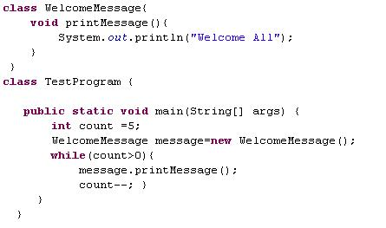
While Statement Example
Develop the code as illustrated below.

Slide 32
do-while Statement
What is a Do while Loop:
It is similar to while loop except that the do-while execute the block once, and then checks the while condition.
The do-while loop always executes its body at least once, because its conditional expression is at the end of the loop.
Syntax:
do {
statement1;
statement2;
} while(boolean_expression);
Do not forget to use semicolon after the while statement

Slide 33
Illustration of a do while statement
do
Execute repeated code
true
While condition
false
Continue to rest of program

Slide 34
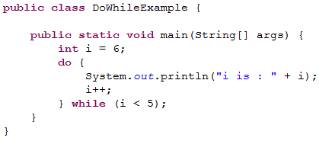

Example of do-while Statement
Example of a do while statement:
The value of i is printed for the first time, even though it does not match the condition i< 5
Output:

Slide 35
Lend a Hand – do while
Create a java class “WelcomeMessage” and add a method named printMessage which would display “Welcome All”.
Create a java class “TestProgram” add a main method which will
  Create an instance of the WelcomeMessage and trigger the method printMessage five times.
  The message “Welcome All” should be displayed 5 times.
The message needs to be displayed in the console.
Use do while Statement

Slide 36
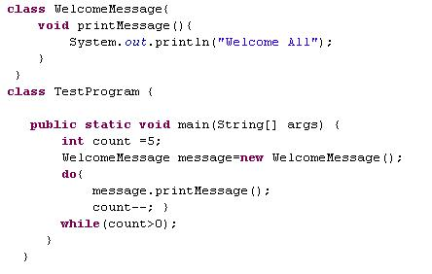
do-while Statement Example
Develop the code as illustrated below.

Slide 37
For Statement
What is a for loop?
For statement is similar to while loop is used to repeat the execution of the code till a condition is met.
The initialization allows to declare and/or initialize loop variables, and is executed only once.
The loopCondition compares the loop variable to some limit value. If the loop condition is not met it is broken.
The iteration usually increments or decrements the values of the loop variables
Syntax:
for(initialization; loopCondition; iteration) {
  statements;
}

Slide 38
Illustration of a for statement
Initialize Loop counter
Update Counter
Is condition true?
Yes
Execute block of commands
No
Program continues..

Slide 39
For Statement Example
class Example{
public static void main(String []args){
for(int i=1; i< 10; i++){
System.out.println(“The Number is “+i);
}
}
Statement Executed in loop
Loop Value Initialized to 1.
Condition for loop, Loop executed till value is < 10
Loop value incremented.

Slide 40
Lend a Hand – For Loop statement
Create a java class “WelcomeMessage” and add a method named printMessage which would display “Welcome All”.
Create a java class “TestProgram” add a main method which will
  Create an instance of the WelcomeMessage. and trigger the method printMessage five times.
  The message “Welcome All” should be displayed 5 times in the console.
The message needs to be displayed in the console.
Use For Loop Statement

Slide 41
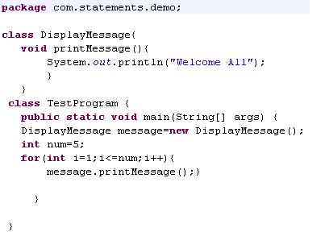
For Statement Example
Develop the code as illustrated below.

Slide 42
Transfer Statement
What are transfer statements?
The transfer Statements in Java alter the normal control flow of the statements. They allow you to redirect the flow of program execution.
Transfer Statements are used to quit either the current iteration of a loop or the entire loop.
Java offers two transfer statements
        break.
        continue.
        return.

Slide 43
Break Statement
Break statement used for,
        Used to terminates a statement sequence in a switch statement.
        Used to exit loops in Iteration Statement.
        Problem statement:
This program iterates through the 100 employees and calculate salary . If one employee is minor age, i.e. age < 18 it should break the loop and stop the execution.
while (employeecount<=100) {
if(employeeAge <18)
{
break;
}
calculateSalary();
}

Slide 44
Continue Statement
Continue Statements stops the processing the remaining code in the body of the particular iteration Statement and continue with the next loop.
        Problem statement:
This program iterates through the 100 employees and calculate salary . If one employee is minor age, i.e. age < 18 it should SKIP the salary calculation logic for the employee and proceed with other employees.
while (employeecount<100) {
if(employeeAge <18)
{
continue;
}
calculateSalary();
}

Slide 45
Continue Statement
Continue Statement can be used within selection statements which are inside iteration statements .
In while and do-while statements, a continue statement causes control to be transferred directly to the conditional expression that controls the loop.
In a for statement, a continue statement skips the current iteration and causes the control to got to the first statement of the loop to proceed with the next iteration.

Slide 46
Return Statement
Return statement:
  The return statement exits from the current method, and the control flow returns to where the method was invoked.
  The return statement has two forms:
    One that returns a value
    One that doesn’t.
  Option 1: To return a value, simply put the value or expression that needs to be returned after the return keyword.
  return <value/expression>;
  Option 2: When the return type of method is void, use the form of return that does not return a value
      return;
  In this case, the execution of the method is stopped.

Slide 47
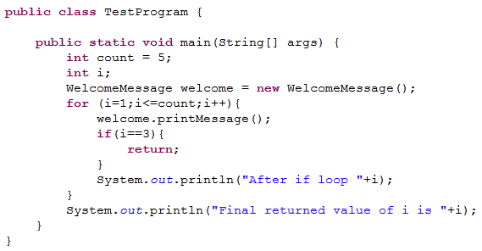

Lend a Hand - Return statement
Let us use the same WelcomeMessage class that we developed for the previous example
When i is equal to 3, the return statement is executed and the execution of the method is stopped
Output
Try the same example with break and continue statement and see how the program behaves.

Slide 48

Time To Reflect
Associates to reflect the following topics before proceeding.
What statements will you use to execute a block of code repetitively.
How to stop a execution of a loop?
Difference between do while and while statement?
What is the difference between switch and If statements?

Slide 49
  Core Java
  You have successfully completed -
  Statements in Java

